Slide 1
Understanding I/O Types
and Event Loops
A Dive into Blocking, Non-blocking I/O and
Event-Driven I/O

Slide 2



VDG
SIGN IN

Slide 3
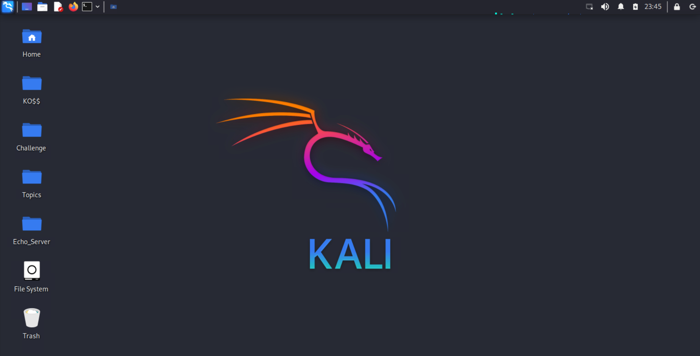



Essential Background
1.Serve-Client Architecture
works on request-response cycle concept.
2. A thread is the smallest unit of execution within a process.
3.JavaScript works single-
threaded and synchronously
4.Node.js is an open-source
cross-platform runtime
environment.
Domains
1. Introduction
2. Blocking vs. Non-blocking I/O
3.Event-loop
4.Event-drive I/O
5.Use of Event Loop in Node.js

Slide 4
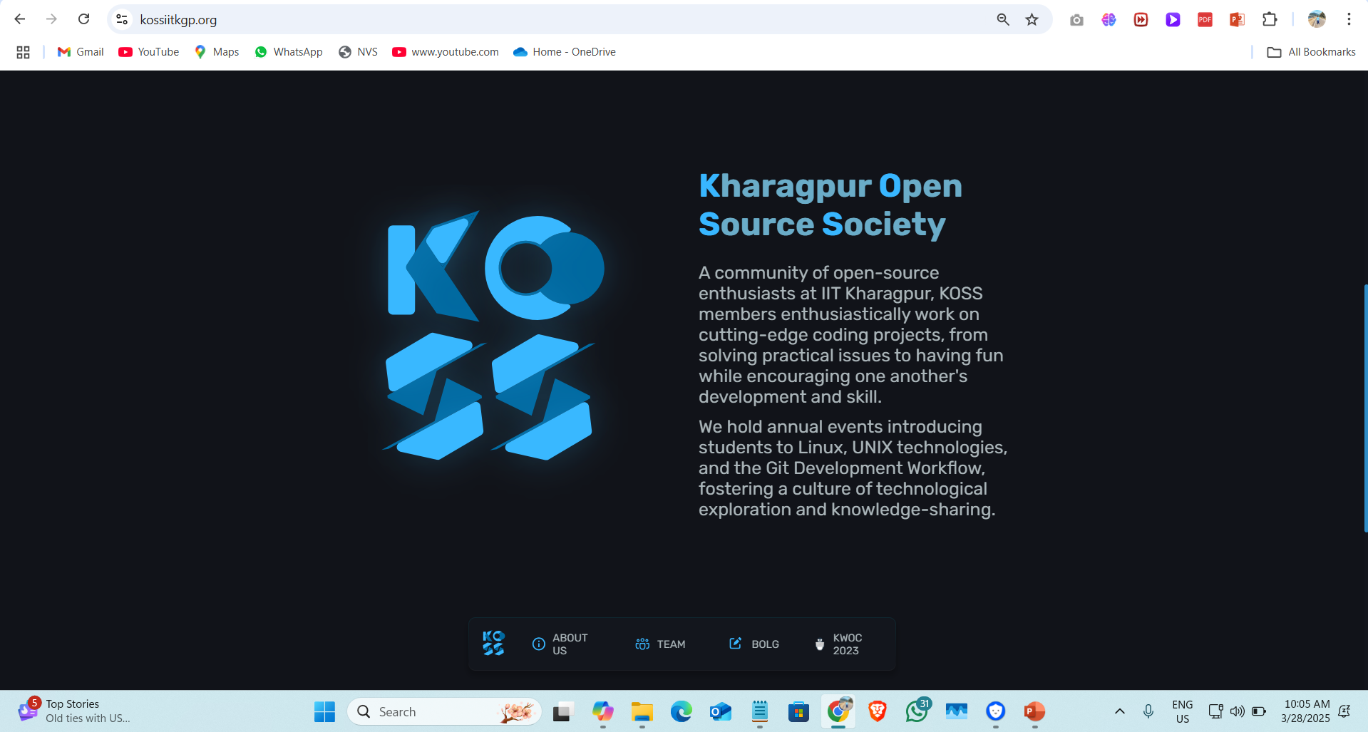


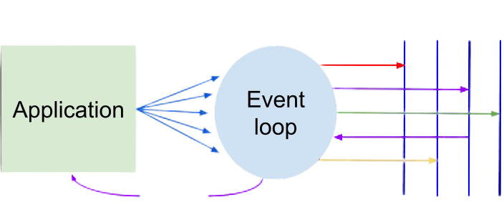
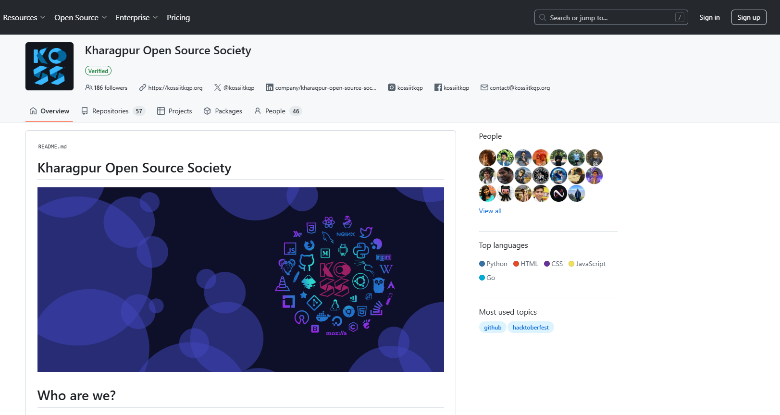
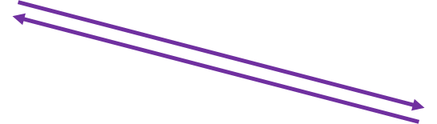

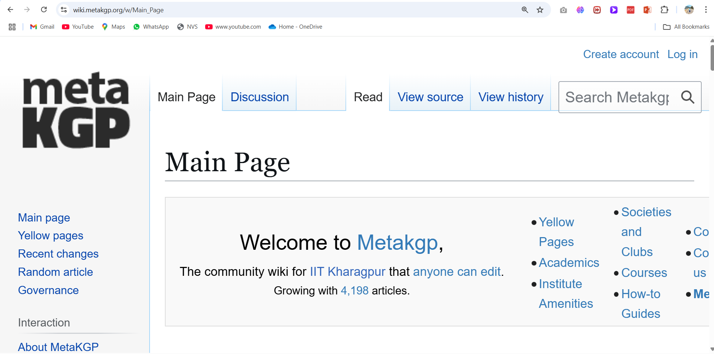
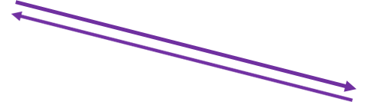
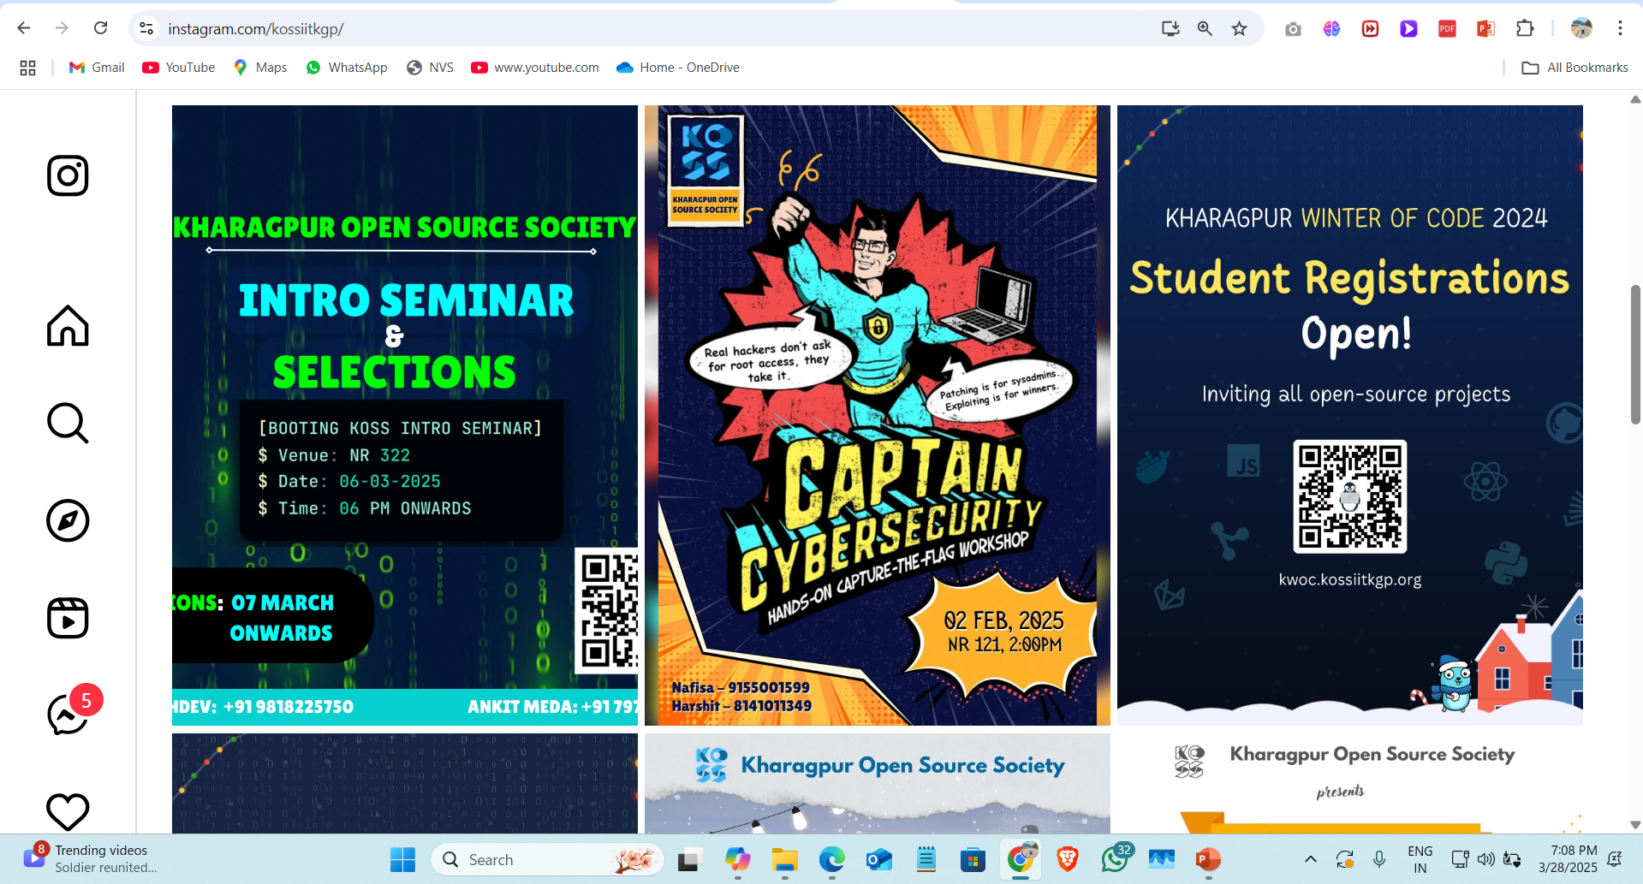
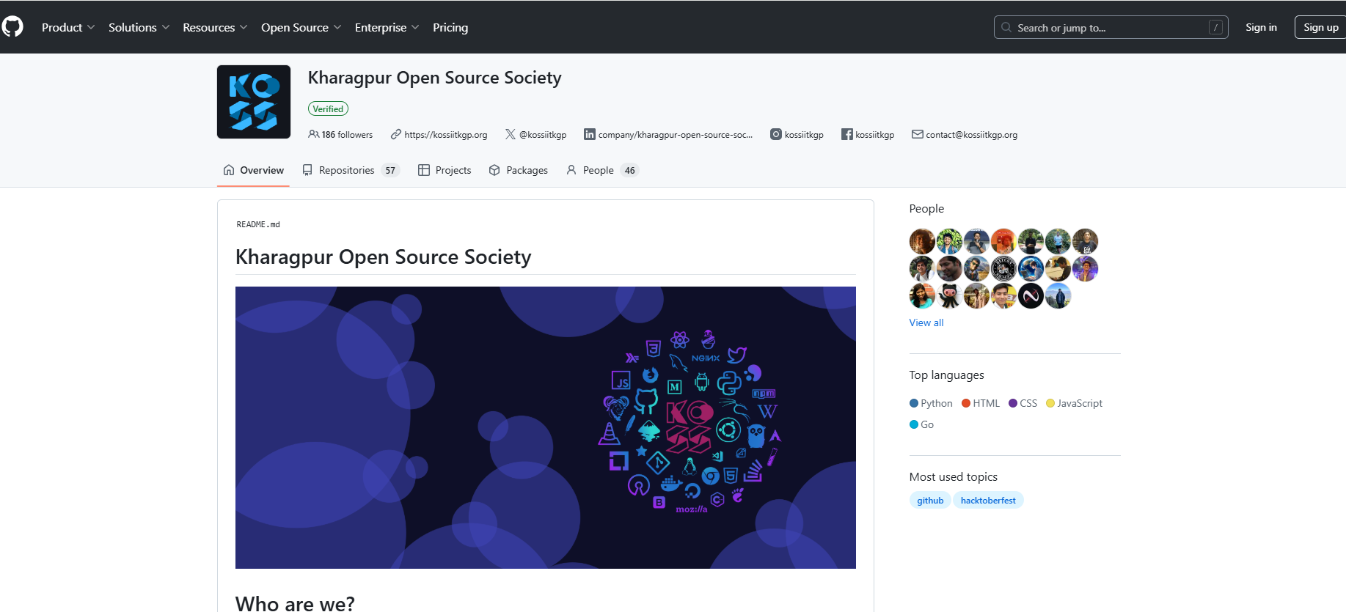
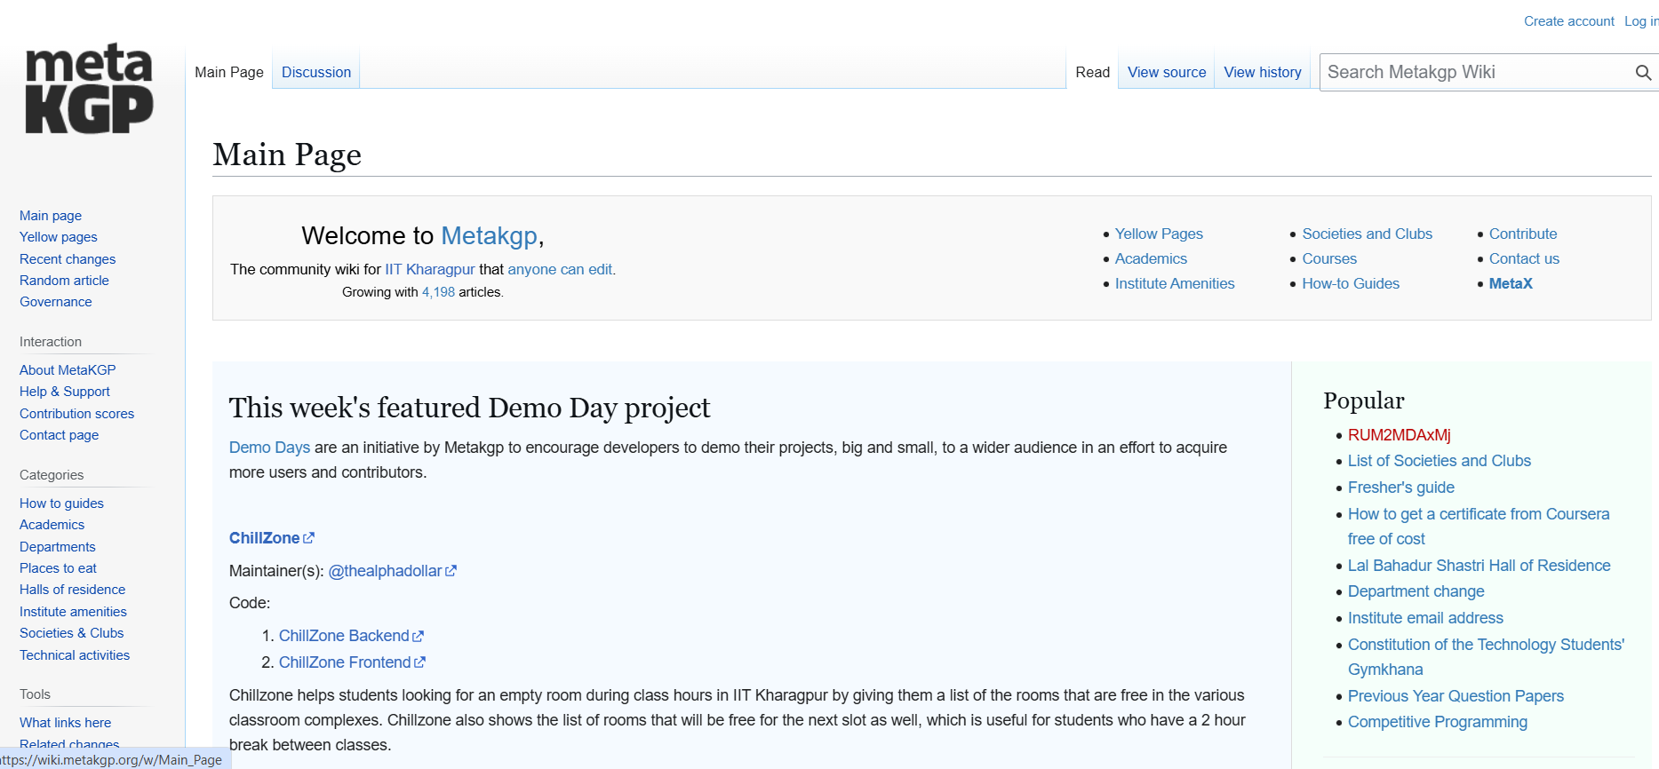

Challenge
What if ?
Request –Response Cycle
Server
Thread Pool
.
.
.
And many more…

Slide 5
Topics
TOPIC 1
TOPIC 2
TOPIC 3
TOPIC 4
TOPIC 5

Slide 6
Topics
TOPIC 1
TOPIC 2
TOPIC 3
TOPIC 4
TOPIC 5
TOPIC 1
Blocking I/O
Blocks executing thread until the operation is complete.
This can lead to inefficiencies and create latency .
Synchronous methods in the Node.js are the most commonly used blocking operations.
Often used in traditional programming paradigms but may not scale
well in modern, event-driven systems.

Slide 7
Topics
TOPIC 1
TOPIC 2
TOPIC 3
TOPIC 4
TOPIC 5
TOPIC 2
Non-blocking I/O
Allows the thread to continue execution while the I/O operation is in progress.
Returns immediately with a status, enabling concurrent processing.
Commonly used in event-driven and asynchronous systems for scalability.
Suitable for high-performance applications where responsiveness is crucial.

Slide 8


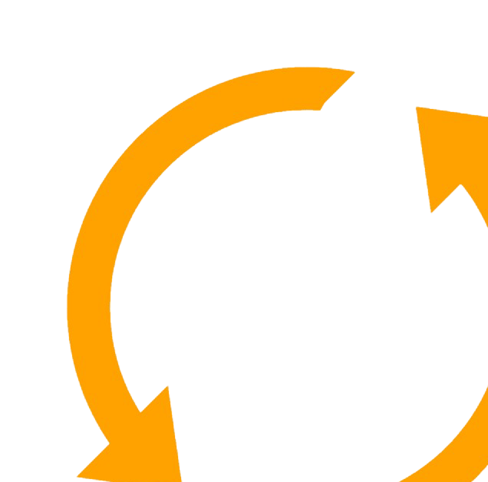
Topics
TOPIC 1
TOPIC 2
TOPIC 3
TOPIC 4
TOPIC 5
TOPIC 3
Event Loop
It is the mechanism that allows Node.js to handle asynchronous operations non blockingly .
It continuously checks the call stack and callback queue to execute pending tasks.
Supports handling of thousands of concurrent connections efficiently.
Timers
Pending callback
Close callback
microtask
idle,
prepare
Check
Poll
Phases of Event Loop

Slide 9
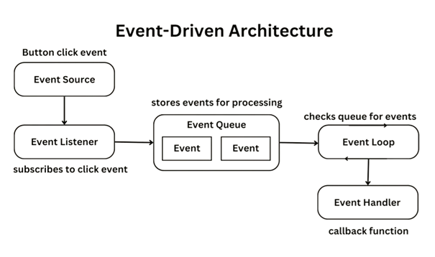
Topics
TOPIC 1
TOPIC 2
TOPIC 3
TOPIC 4
TOPIC 5
TOPIC 4
Event-Driven I/O
It is a programming model where events trigger actions instead of following a strict sequence of execution.
When the operation completes, an event is emitted, and the corresponding callback is executed.
Key Components: Event Loop,Callbacks & Listeners
Event Emitter

Slide 10
Topics
TOPIC 1
TOPIC 2
TOPIC 3
TOPIC 4
TOPIC 5
TOPIC 5
Use of the event loop in Node.js
Handling I/O Operations: Manages tasks like reading files, writing to databases, or network requests without blocking the main thread.
Efficient Resource Utilization: Operates on a single thread, minimizing overhead compared to multithreaded systems.
Enables event-driven programming
High Scalability : Efficiently manages multiple requests
Queue management: Qrganize tasks into different phases.

Slide 11
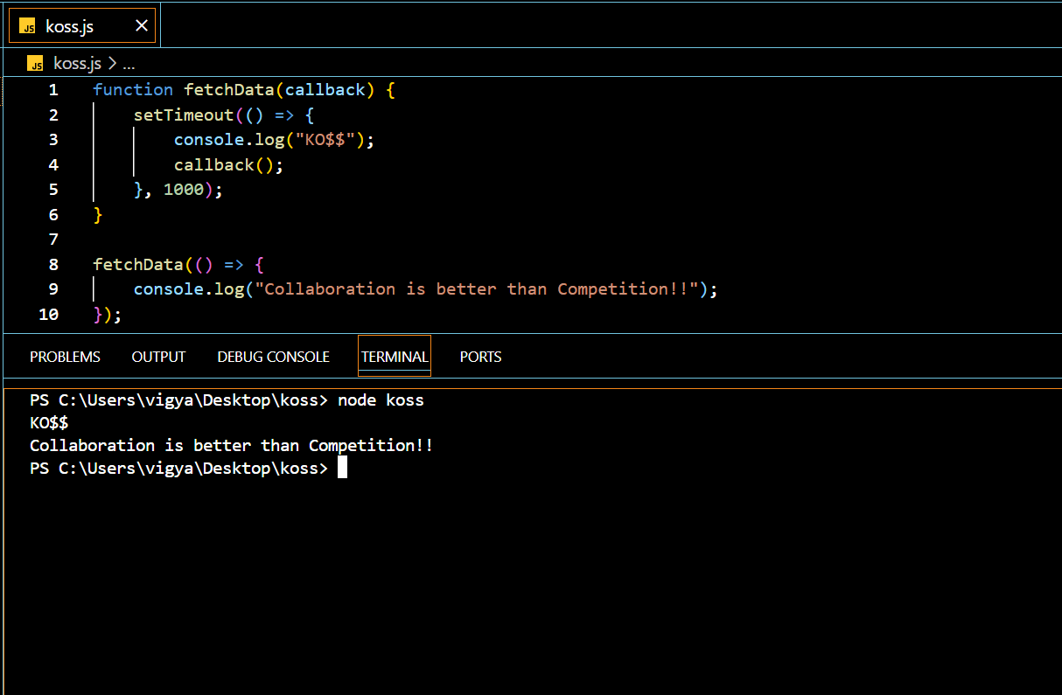
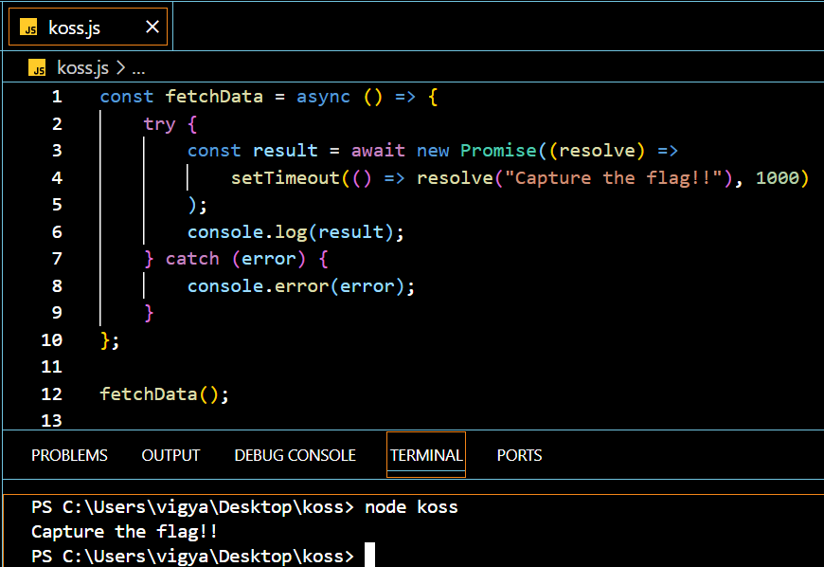
Asynchronous Adventures
1.Callbacks
A callback is a function passed as an argument to another function. Once the asynchronous operation completes, the callback is executed.
2. Async/Await
Introduced in ES8, allows you to write asynchronous code that looks synchronous, making it easier to read and debug.

Slide 12
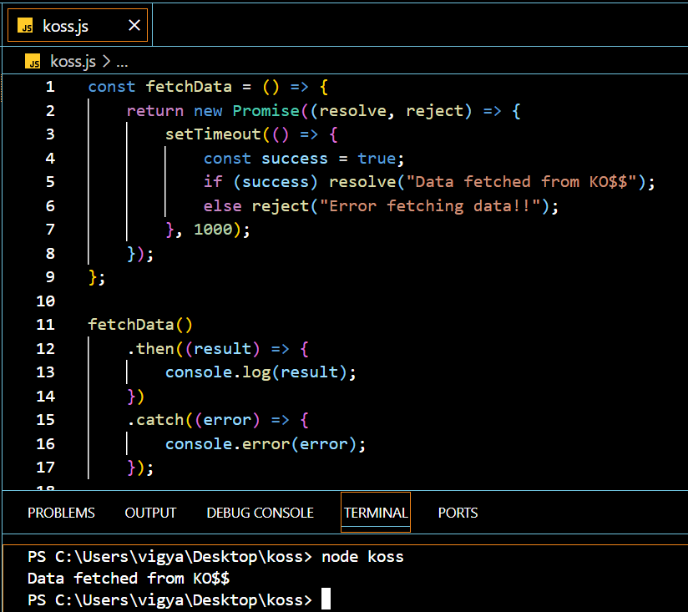
Asynchronous Adventures
3.Promise
Promises offer a cleaner way to handle asynchronous code by chaining and methods

Slide 13
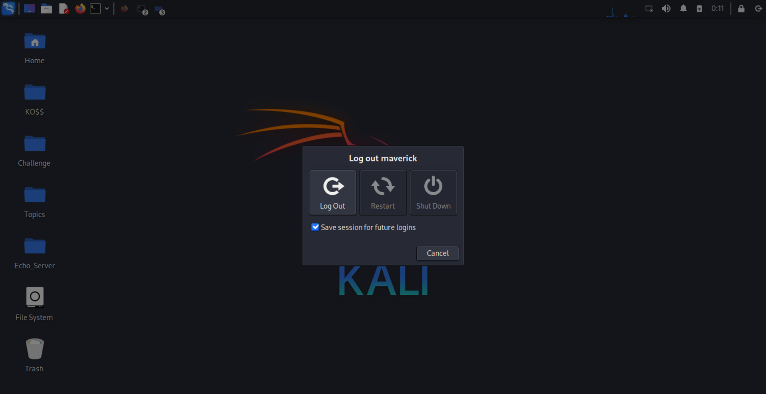
Thank you for Listening !

